Slide 1
Mobile-Commerce Development
Lesson
Advanced Views in Android
Lecturer:
Tran Duy Thanh, Phd
Nguyen Quang Phuc, Msc
Email: thanhtd@uel.edu.vn
Blog: https://tranduythanh.com
Phone: 0987773061

Slide 2
Lesson Objective
-Students can use Basic Listview, Spinner
-Students understand the running mechanism Custom Adapter
-Students can present Product with Advanced Listview, GridView, RecyclerView.
-Applied Data for DatePicker and TimePicker
-Separate screen with Tabhost
-Do the menu (Option Menu, Context Menu, Menu Search View) as well

Slide 3
Outlines
ListView
GridView
RecyclerView
Spinner
AutoCompleteTextView
Date and Time Picker
TabHost
Menu

Slide 4
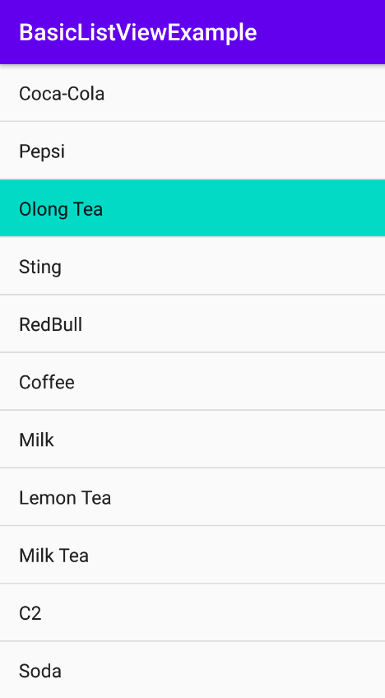
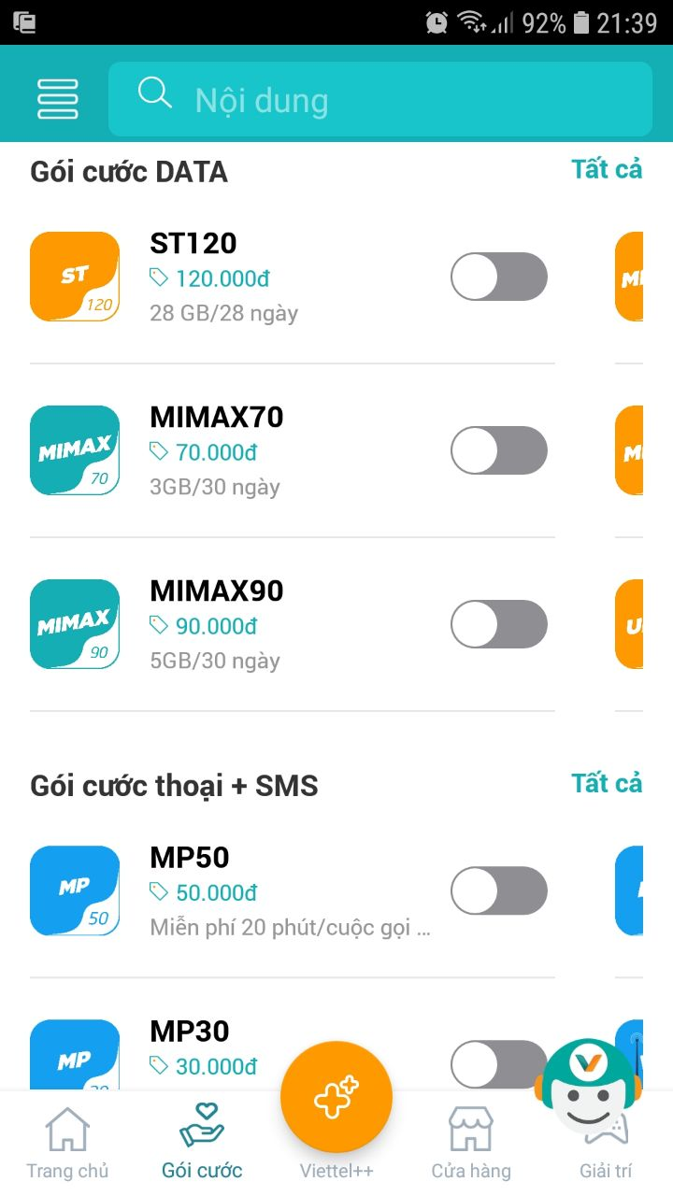
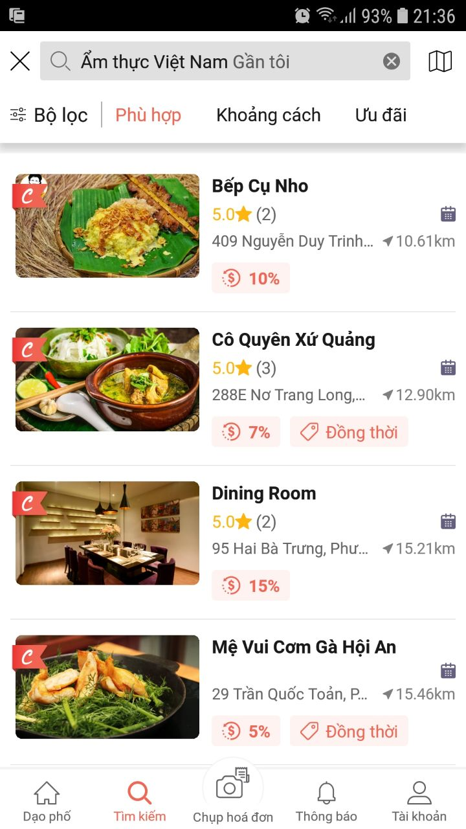
1. ListView
ListView is a View that allows displaying data in lines.

Slide 5
1. ListView
Steps to use basic ListView:
Step 1: Create a data source displayed on ListView, We can use ArrayList, regular array, object array, ...
Step 2: Create ListView on the graphic user interface
Step 3: Create an ArrayAdapter object to link between the source data (array or list) and ListView
Step 4: Assign Adapter object to Listview

Slide 6
1. ListView
Steps to use basic ListView:
//Step 1. Create Data source String [] drinks = {"Coca-Cola", "Pepsi", "Olong Tea", "Sting", "RedBull", "Coffee", "Milk", "Lemon Tea", "Milk Tea", "C2", "Soda"};
//Step 2. Create ListView instance
lvDrinks = findViewById(R.id.lvDrinks);
//Step 3. Create ArrayAdapter object
arrayAdapter = new ArrayAdapter<String>(this, android.R.layout.simple_list_item_1, drinks);
//Step 4. Assign adapter to Listview
lvDrinks.setAdapter(arrayAdapter);

Slide 7
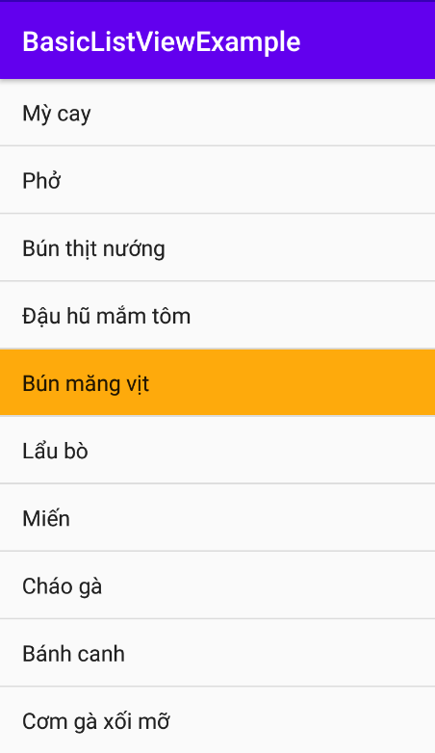
1. ListView
Steps to use basic ListView:
<string-array name="myFoods"> <item>Mỳ cay</item> <item>Phở</item> <item>Bún thịt nướng</item> <item>Đậu hũ mắm tôm</item> <item>Bún măng vịt</item> <item>Lẩu bò</item> <item>Miến</item> <item>Cháo gà</item> <item>Bánh canh</item> <item>Cơm gà xối mỡ</item> </string-array>
String [] foods = getResources().getStringArray(R.array.myFoods);

Slide 8
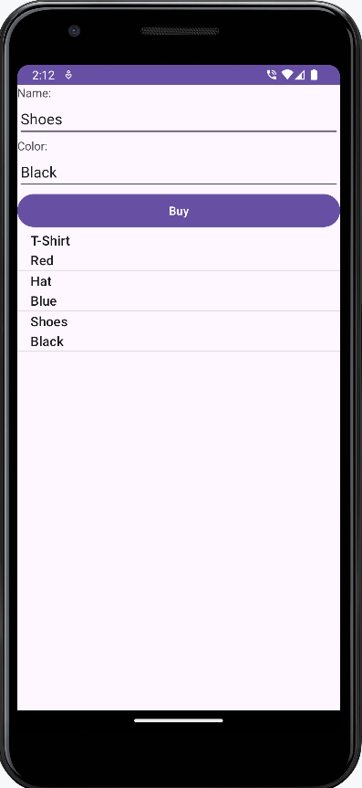
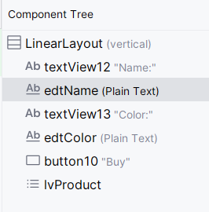
1. ListView
Data source is List Object Model
public class Product implements Serializable { private String name; private String color; public Product() { } public Product(String name, String color) { this.name = name; this.color = color; } public String getName() { return name; } public void setName(String name) { this.name = name; } public String getColor() { return color; } public void setColor(String color) { this.color = color; } @NonNull @Override public String toString() { return this.name+"\n"+this.color; } }

Slide 9
1. ListView
Data source is List Object Model
private void addViews() { edtName=findViewById(R.id.edtName); edtColor=findViewById(R.id.edtColor); lvProduct=findViewById(R.id.lvProduct); adapterProduct=new ArrayAdapter<>(this,
android.R.layout.simple_list_item_1); lvProduct.setAdapter(adapterProduct); adapterProduct.add(new Product("T-Shirt","Red")); adapterProduct.add(new Product("Hat","Blue")); adapterProduct.add(new Product("Shoes","Black")); }

Slide 10
1. ListView
Data source is List Object Model
public void buyProduct(View view) { Product product=new Product(); product.setName(edtName.getText().toString()); product.setColor(edtColor.getText().toString()); adapterProduct.add(product); edtName.setText(""); edtColor.setText(""); edtName.requestFocus(); }

Slide 11
1. ListView
private void addEvents() { lvProduct.setOnItemClickListener(new AdapterView.OnItemClickListener() { @Override public void onItemClick(AdapterView<?> adapterView, View view, int i, long l) { Product product=adapterProduct.getItem(i); edtName.setText(product.getName()); edtColor.setText(product.getColor()); } }); lvProduct.setOnItemLongClickListener(new AdapterView.OnItemLongClickListener() { @Override public boolean onItemLongClick(AdapterView<?> adapterView, View view, int i, long l) { Product product=adapterProduct.getItem(i); adapterProduct.remove(product); return false; } }); }

Slide 12
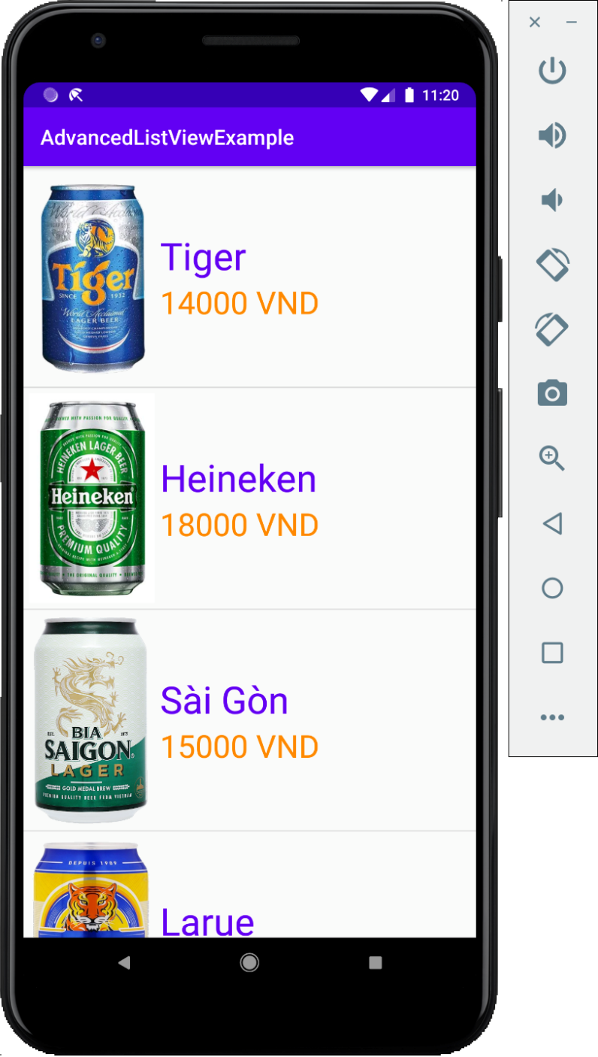
1. ListView
Complex ListView

Slide 13
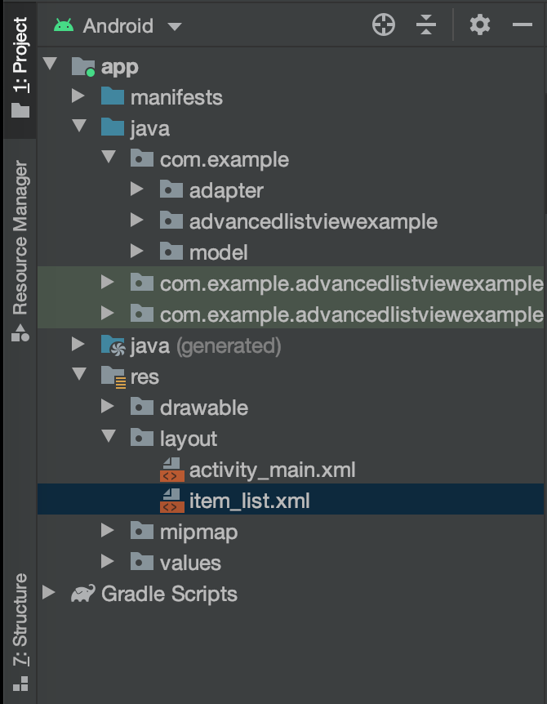
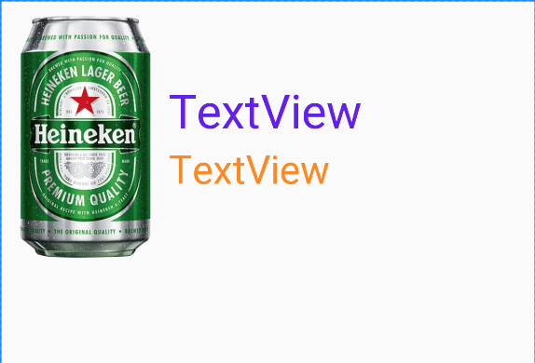
1. ListView
Design the layout for an item of ListView

Slide 14
1. ListView
Design a Class Object
public class SanPham implements Serializable { private int imageId; private String ten; private double gia; public SanPham() {} public SanPham(int imageId, String ten, double gia) { this.imageId = imageId; this.ten = ten; this.gia = gia; } public int getImageId() {return imageId;} public void setImageId(int imageId) {this.imageId = imageId;} public String getTen() {return ten;} public void setTen(String ten) {this.ten = ten;} public double getGia() {return gia;} public void setGia(double gia) {this.gia = gia;} }

Slide 15
1. ListView
Design a Custom Adapter
public class SanPhamAdapter extends ArrayAdapter<SanPham> { Activity context; int resource; public SanPhamAdapter(@NonNull Activity context, int resource) { super(context, resource); this.context = context; this.resource = resource; } …

Slide 16
1. ListView
Design a Custom Adapter
public View getView(int position, @Nullable View convertView, @NonNull ViewGroup parent) { LayoutInflater inflater = this.context.getLayoutInflater(); View customView = inflater.inflate(this.resource, null);
ImageView imgHinh = customView.findViewById(R.id.imgHinh); TextView txtTen = customView.findViewById(R.id.txtTen); TextView txtGia = customView.findViewById(R.id.txtGia);
SanPham sp = getItem(position); imgHinh.setImageResource(sp.getImageId()); txtTen.setText(sp.getTen()); txtGia.setText(String.format("%.0f", sp.getGia()) + " VND");
return customView; } }

Slide 17
1. ListView
In Activity
ListView lvSanPham; SanPhamAdapter sanPhamAdapter;
lvSanPham = findViewById(R.id.lvSanPham);
sanPhamAdapter = new SanPhamAdapter(MainActivity.this, R.layout.item_list);
sanPhamAdapter.add(new SanPham(R.drawable.tiger, "Tiger", 14000)); sanPhamAdapter.add(new SanPham(R.drawable.heiniken, "Heineken", 18000)); sanPhamAdapter.add(new SanPham(R.drawable.saigon, "Sài Gòn", 15000)); sanPhamAdapter.add(new SanPham(R.drawable.larue, "Larue", 12000)); sanPhamAdapter.add(new SanPham(R.drawable.sapporo, "Sapporo", 17000)); sanPhamAdapter.add(new SanPham(R.drawable.hanoi, "Hà Nội", 16000)); sanPhamAdapter.add(new SanPham(R.drawable.beer333, "Bia 333", 15000));
lvSanPham.setAdapter(sanPhamAdapter);

Slide 18
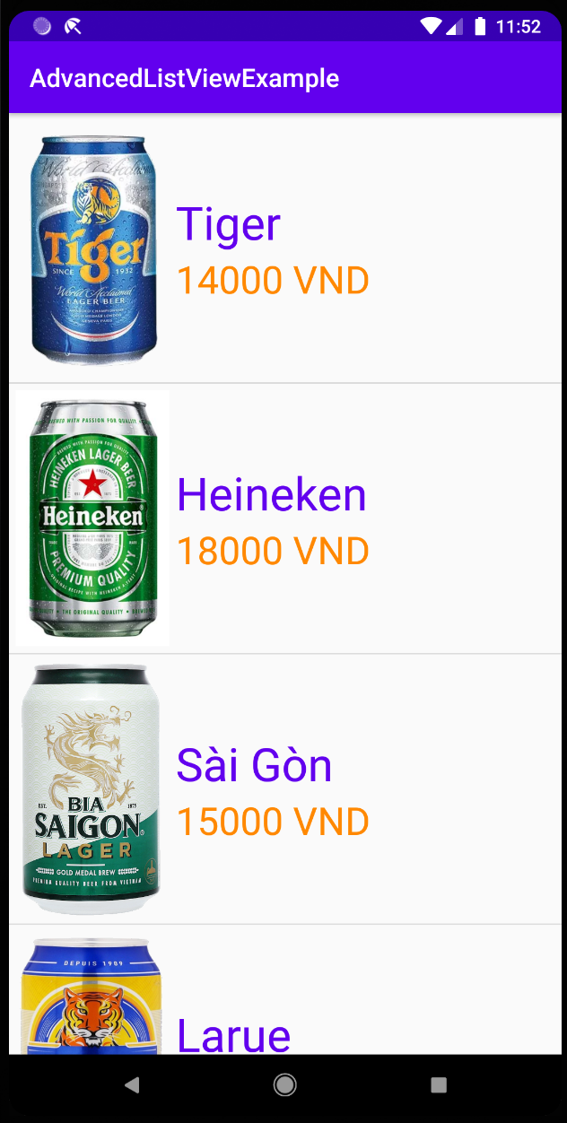
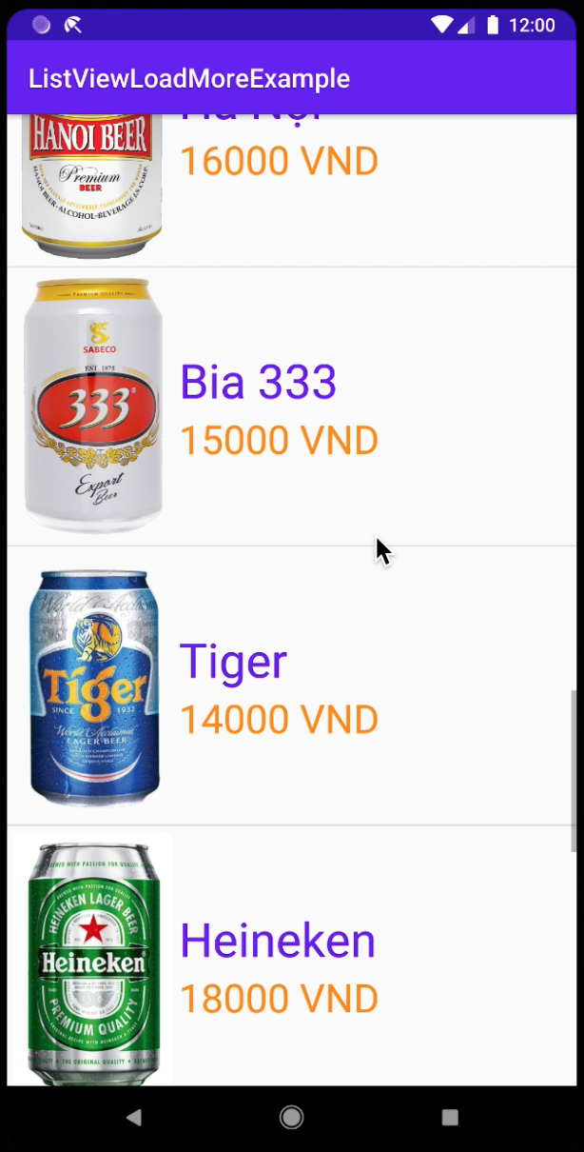
1. ListView
In Activity

Slide 19
2. GridView
GridView is a View that allows displaying data in tabular form (rows and columns).
The way to create and use GridView is completely similar to ListView.
Set the number of columns displayed on the GridView through the numColumns property.
<GridView android:id="@+id/gvSanPham" android:layout_width="match_parent" android:layout_height="match_parent" android:listSelector="@android:color/holo_blue_bright" android:numColumns="3" />

Slide 20
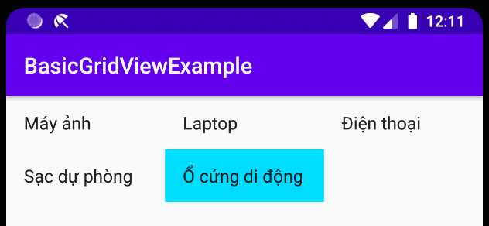
2. GridView
Basic GridView
//1. Create data source for GridView
ArrayList<String>dsSP = new ArrayList<>(); dsSP.add("Máy ảnh"); dsSP.add("Laptop"); dsSP.add("Điện thoại"); dsSP.add("Sạc dự phòng"); dsSP.add("Ổ cứng di động");
//2. Refer to the GridView on the interface via Id
gvSanPham = findViewById(R.id.gvSanPham);
//3. Assign the data source to the ArrayAdapter object arrayAdapter = new ArrayAdapter<String>(MainActivity.this, android.R.layout.simple_list_item_1);
arrayAdapter.addAll(dsSP);
//4. Display data on a smart GridView
// via ArrayAdapter object gvSanPham.setAdapter(arrayAdapter);

Slide 21
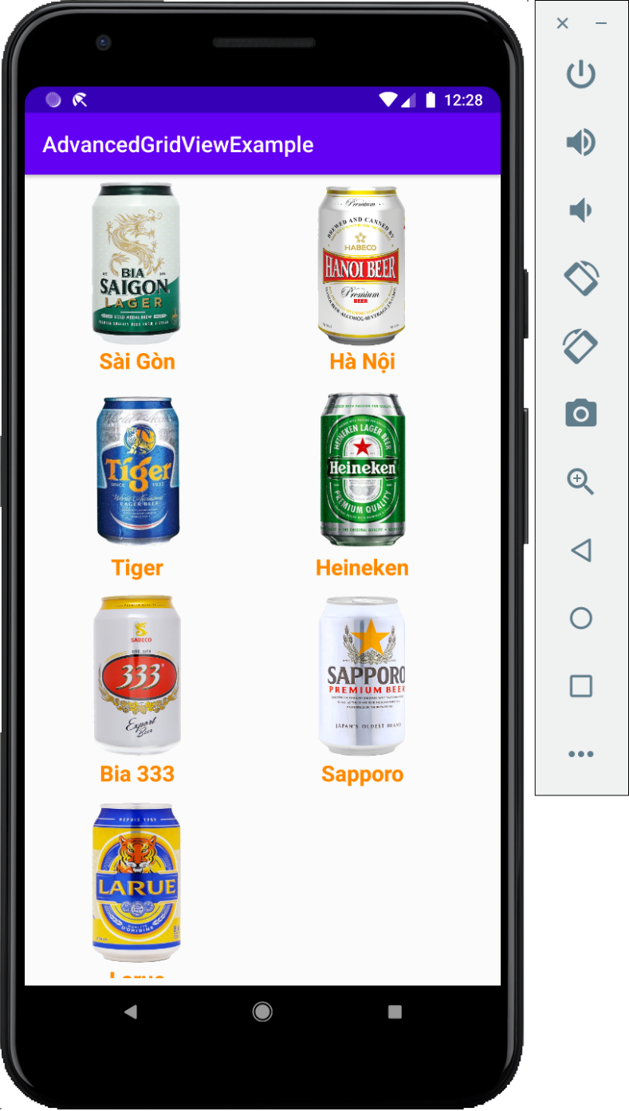
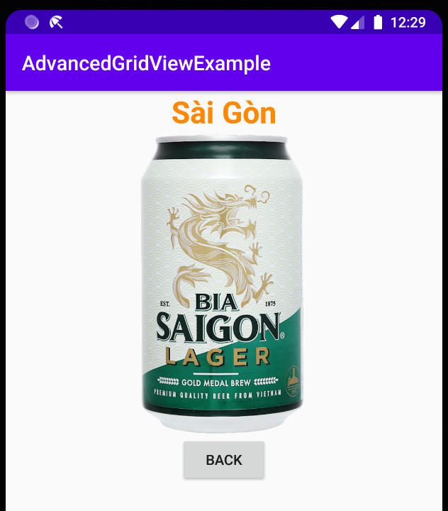
2. GridView
Complex GridView

Slide 22
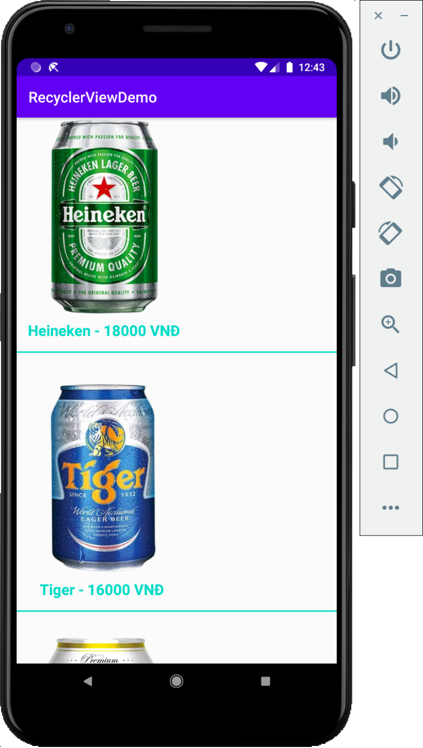
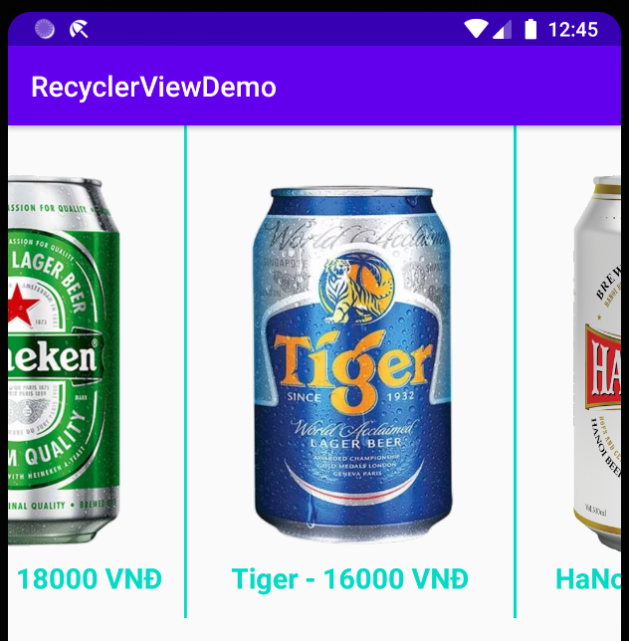
3. RecyclerView
RecyclerView is a type of View that allows displaying list data similar to ListView but allows programmers to deeply customize the interface and display method.

Slide 23
3. RecyclerView
//1. Create CustomAdapter
public class SanPhamAdapter extends RecyclerView.Adapter<SanPhamAdapter.ViewHolder>{ … }
//2. Create a ViewHolder that references views on the interface for an item
public class ViewHolder extends RecyclerView.ViewHolder{ ImageView imgPhoto; TextView txtInfo; public ViewHolder(@NonNull View itemView) { super(itemView); imgPhoto = itemView.findViewById(R.id.imgPhoto); txtInfo = itemView.findViewById(R.id.txtInfo); itemView.setOnClickListener(new View.OnClickListener() { @Override public void onClick(View view) { RemoveItem(getAdapterPosition()); Toast.makeText(context, "Remove " + txtInfo.getText(),
Toast.LENGTH_SHORT).show(); } }); } }

Slide 24
3. RecyclerView
//3. Load item layout to ViewHolder
@NonNull @Override public ViewHolder onCreateViewHolder(@NonNull ViewGroup parent, int viewType) { LayoutInflater layoutInflater =
LayoutInflater.from(parent.getContext()); View customItemView =
layoutInflater.inflate(R.layout.custom_item, parent, false); return new ViewHolder(customItemView); }

Slide 25
3. RecyclerView
//4. Binding data to ViewHolder
@Override public void onBindViewHolder(@NonNull ViewHolder holder, int position) {
holder.imgPhoto.setImageResource(dsSanPham.get(position).getHinh()); holder.txtInfo.setText(dsSanPham.get(position).getTen() + " - " +
String.format("%.0f", dsSanPham.get(position).getGia()) + " VNĐ"); }

Slide 26
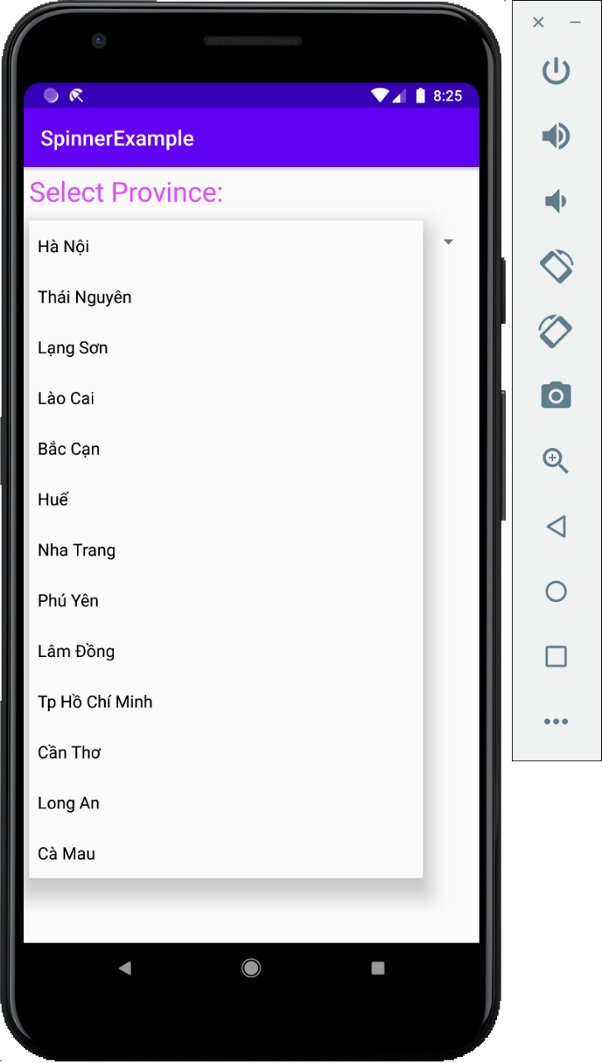
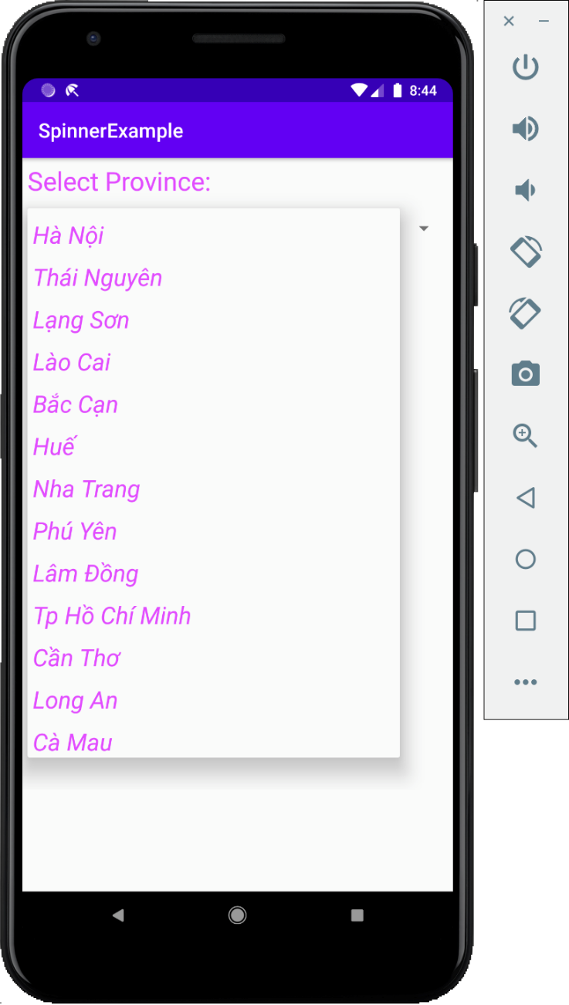
4. Spinner
Spinner is a type of View similar to ComboBox (C#), JComboBox (Java)

Slide 27

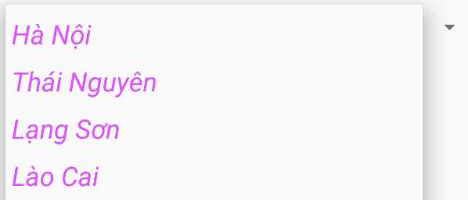
4. Spinner
spinnerProvince = findViewById(R.id.spinnerProvince); adapter = new ArrayAdapter<>(
MainActivity.this, android.R.layout.spinner_item);
adapter.setDropDownViewResource(android.R.layout.spinner_list);
spinnerProvince.setAdapter(adapter);

Slide 28
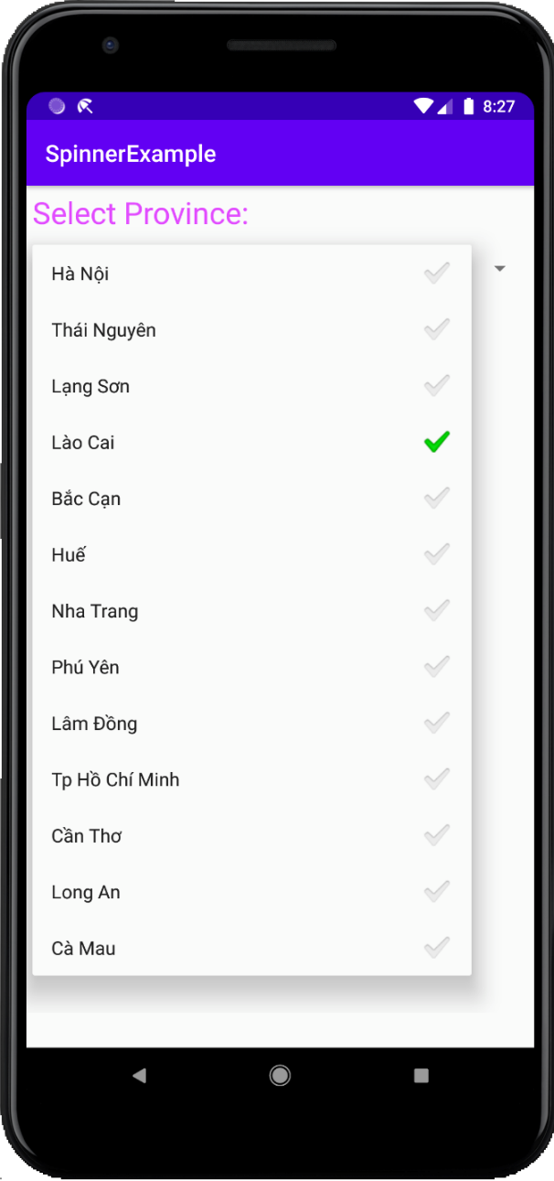

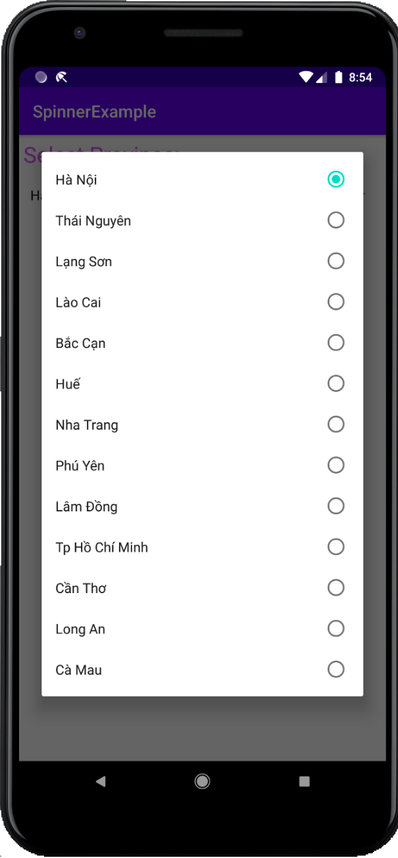
4. Spinner

Slide 29
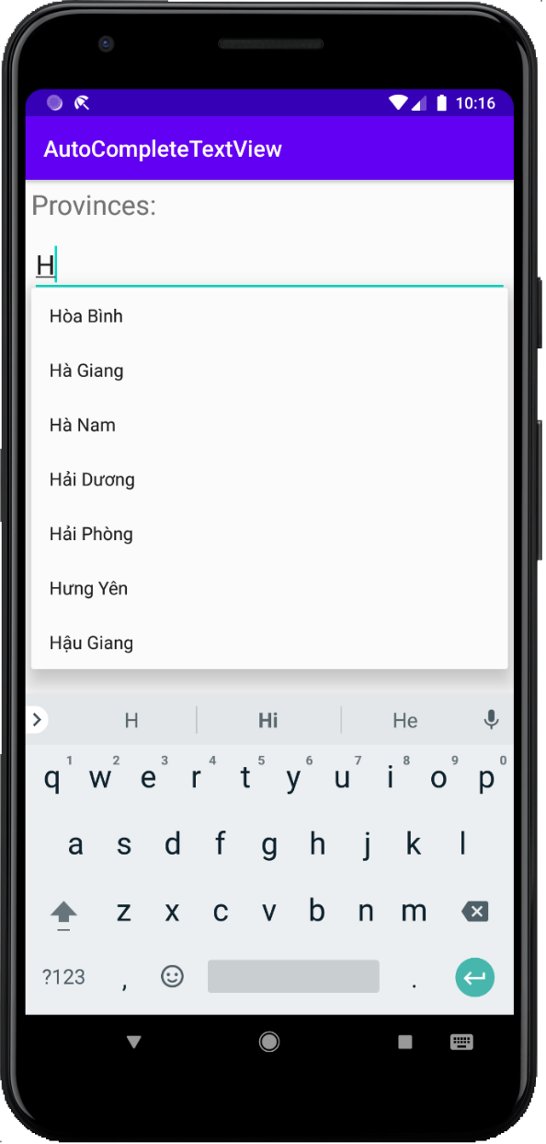
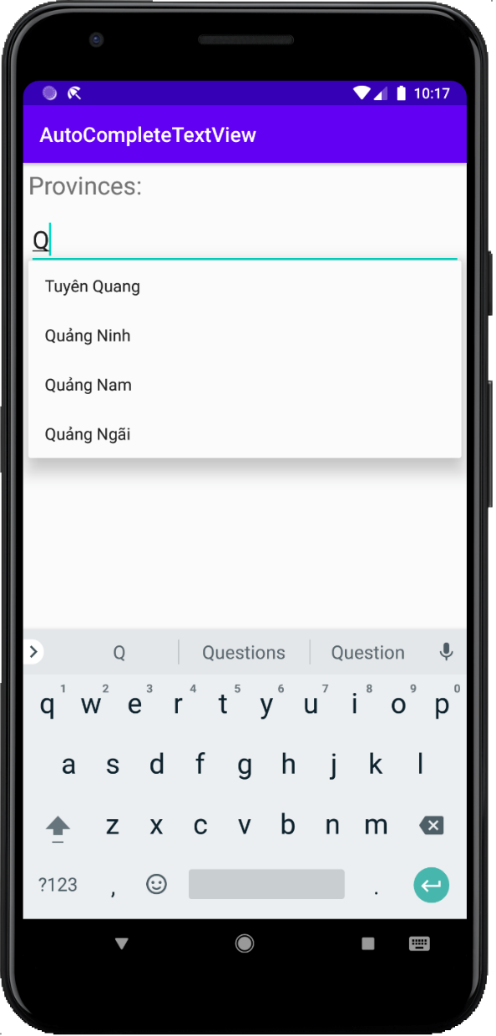
5. AutoCompleteTextView
AutoCompleteTextView is a View that supports user input suggestions.

Slide 30
5. AutoCompleteTextView
strings.xml
<resources> <string name="app_name">BookStore</string> <string-array name="provinces_name"> <item>Hà Nội</item> <item>Hồ Chí Minh</item> <item>Cần Thơ</item> </string-array> </resources>

Slide 31
5. AutoCompleteTextView
<AutoCompleteTextView android:id="@+id/autoCompleteTextView" android:layout_width="match_parent" android:layout_height="wrap_content" android:textSize="24sp" android:layout_margin="5dp" android:completionThreshold="1"/>
completeTextViewProvince =
findViewById(R.id.autoCompleteTextView);
adapter = new ArrayAdapter<>(MainActivity.this,
android.R.layout.simple_list_item_1);
adapter.addAll(getResources().getStringArray(R.array.provinces_name));
completeTextViewProvince.setAdapter(adapter);

Slide 32
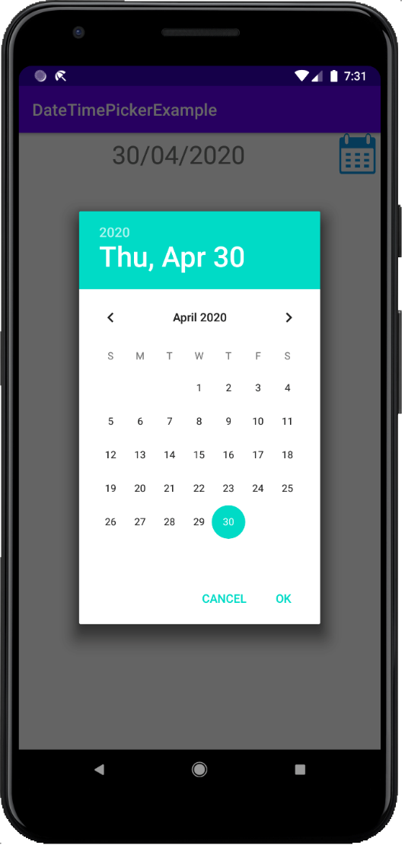
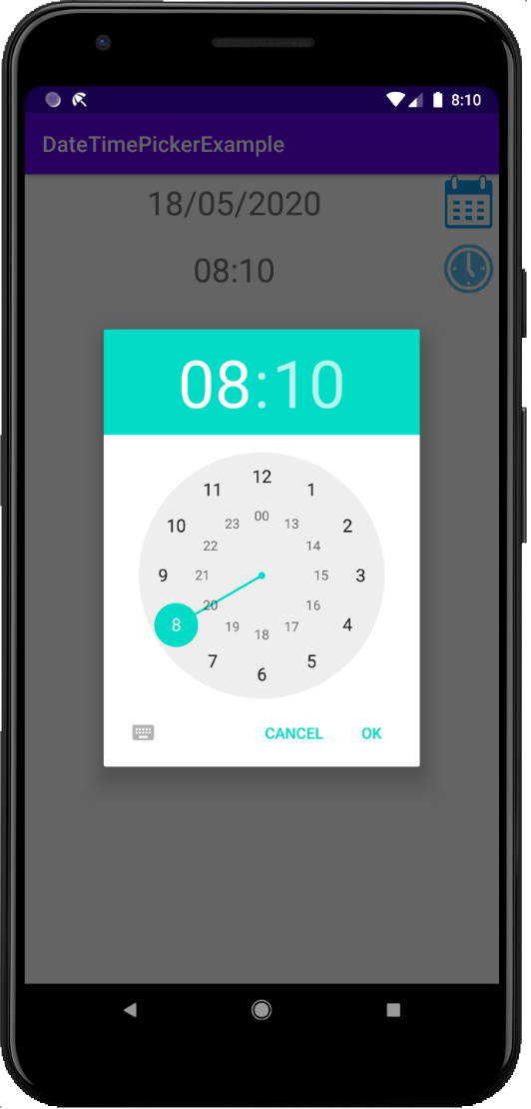
6. Date and Time Picker
DatePicker is a View that helps users select dates.
TimePicker is a View that helps users select hours and minutes.

Slide 33
6. Date and Time Picker
Calendar calendarDate = Calendar.getInstance(); SimpleDateFormat dateFormat = new SimpleDateFormat("dd/MM/yyyy");
DatePickerDialog.OnDateSetListener callBack = new DatePickerDialog.OnDateSetListener() { @Override public void onDateSet(DatePicker datePicker, int i, int i1, int i2) { calendarDate.set(Calendar.YEAR, i); calendarDate.set(Calendar.MONTH, i1); calendarDate.set(Calendar.DAY_OF_MONTH, i2); txtDate.setText(dateFormat.format(calendarDate.getTime())); } }; DatePickerDialog datePickerDialog = new DatePickerDialog( MainActivity.this, callBack, calendarDate.get(Calendar.YEAR), calendarDate.get(Calendar.MONTH), calendarDate.get(Calendar.DAY_OF_MONTH)); datePickerDialog.show();
DatePicker

Slide 34
6. Date and Time Picker
Calendar calendarTime = Calendar.getInstance(); SimpleDateFormat timeFormat = new SimpleDateFormat("HH:mm");
TimePickerDialog.OnTimeSetListener callBack = new
TimePickerDialog.OnTimeSetListener() { @Override public void onTimeSet(TimePicker timePicker, int i, int i1) { calendarTime.set(Calendar.HOUR, i); calendarTime.set(Calendar.MINUTE, i1); txtTime.setText(timeFormat.format(calendarTime.getTime())); } }; TimePickerDialog timePickerDialog = new TimePickerDialog( MainActivity.this, callBack, calendarTime.get(Calendar.HOUR), calendarTime.get(Calendar.MINUTE), true); timePickerDialog.show();
TimePicker

Slide 35
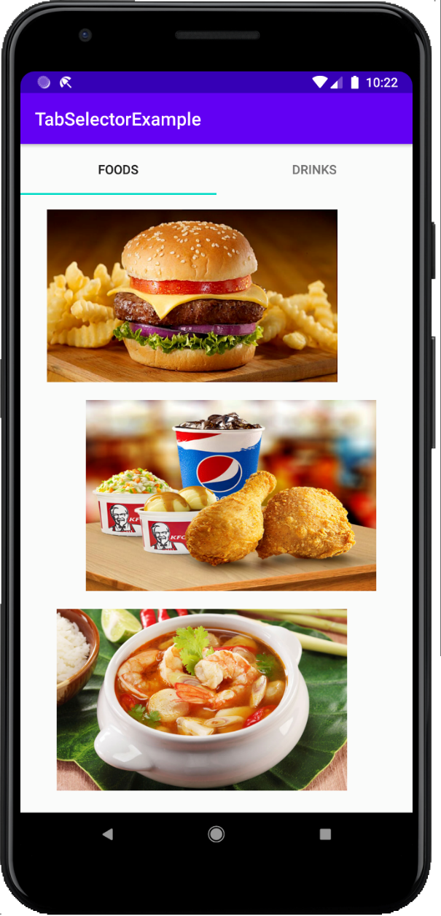
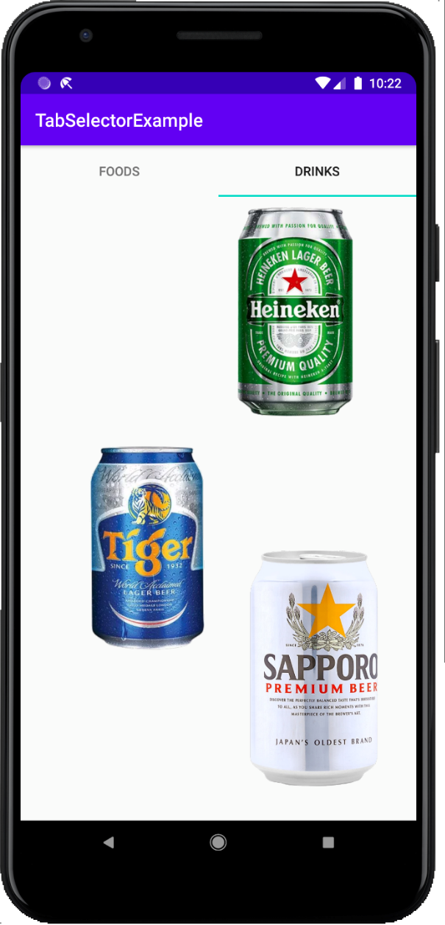
7. TabHost
TabHost is a View similar to Tab control in C# and Java.
TabHost allows display: Different interfaces in a certain area of the screen.

Slide 36
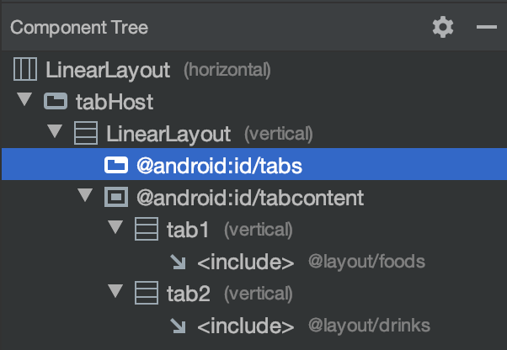
7. TabHost
TabHost components:
Tab 1
Tab 2
Tab 3
Tab Widget
FrameLayout
FrameLayout

Slide 37
7. TabHost
tabHost = findViewById(R.id.tabHost); tabHost.setup();
//Tạo tab 1 TabHost.TabSpec tab1 = tabHost.newTabSpec("tab1"); tab1.setContent(R.id.tab1); tab1.setIndicator("Foods"); tabHost.addTab(tab1);
//Tạo tab 2 TabHost.TabSpec tab2 = tabHost.newTabSpec("tab2"); tab2.setContent(R.id.tab2); tab2.setIndicator("Drinks"); tabHost.addTab(tab2);

Slide 38
7. TabHost
tabHost.setOnTabChangedListener(new
TabHost.OnTabChangeListener() { @Override public void onTabChanged(String s) { Toast.makeText(MainActivity.this, "Tab " + s + " selected, index: " + tabHost.getCurrentTab(), Toast.LENGTH_LONG).show(); } });

Slide 39
8. Menu
8.1. Option Menu
8.2. Context Menu
8.3. Menu Search View

Slide 40
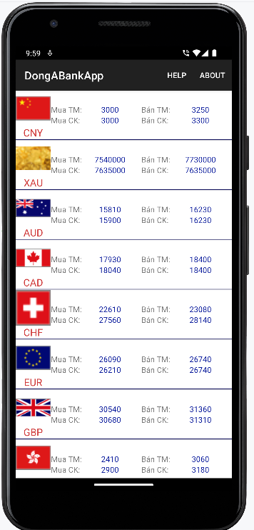
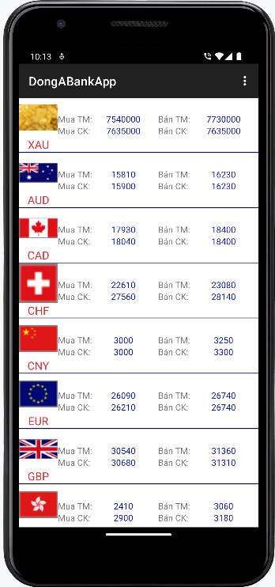
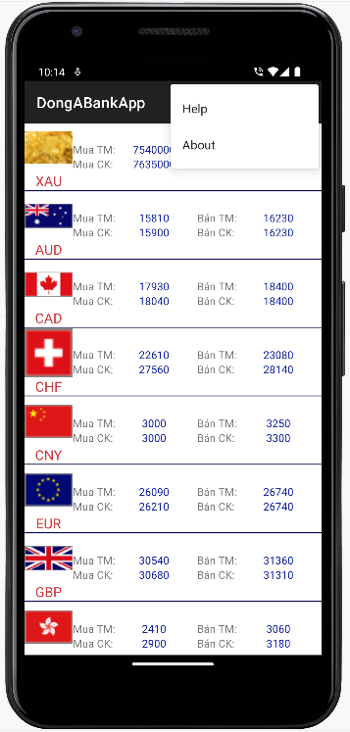
8.1. Option Menu
Option Menu
ActionBar
Type 1
Type 2

Slide 41
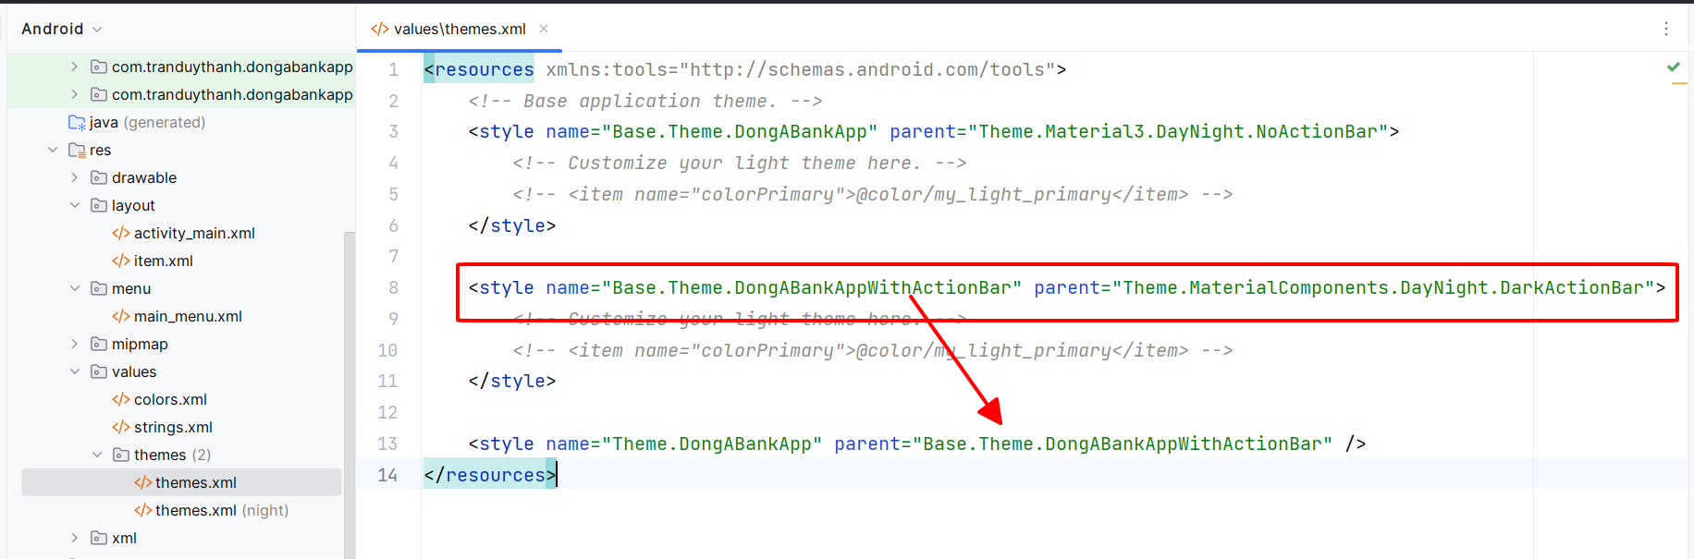
8.1. Option Menu
Step 1: Create new theme

Slide 42
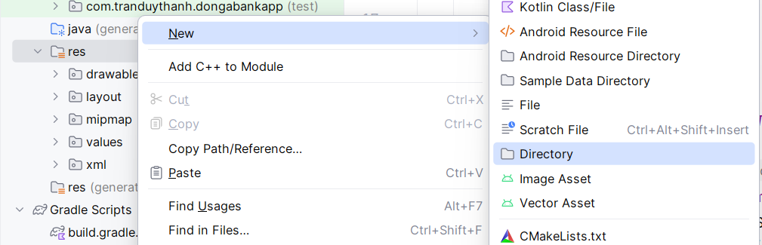
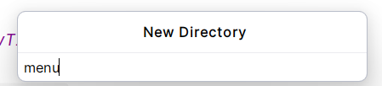
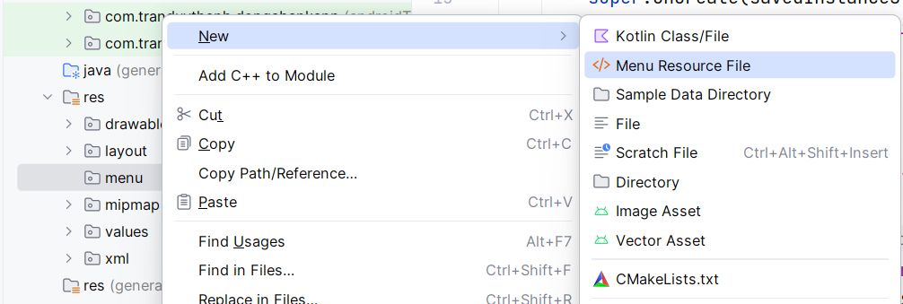
8.1. Option Menu
Step 2: Create menu resource xml

Slide 43
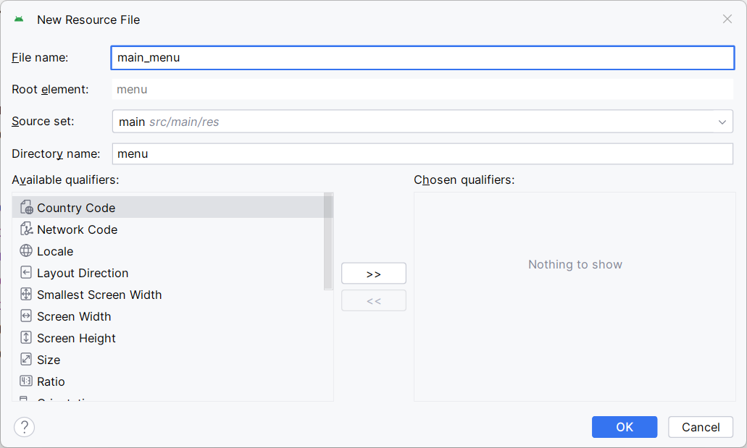
8.1. Option Menu
Step 2: Create menu resource xml

Slide 44
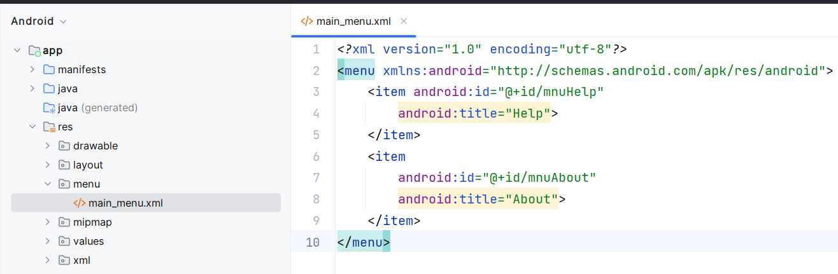
8.1. Option Menu
Step 2: Create menu resource xml

Slide 45
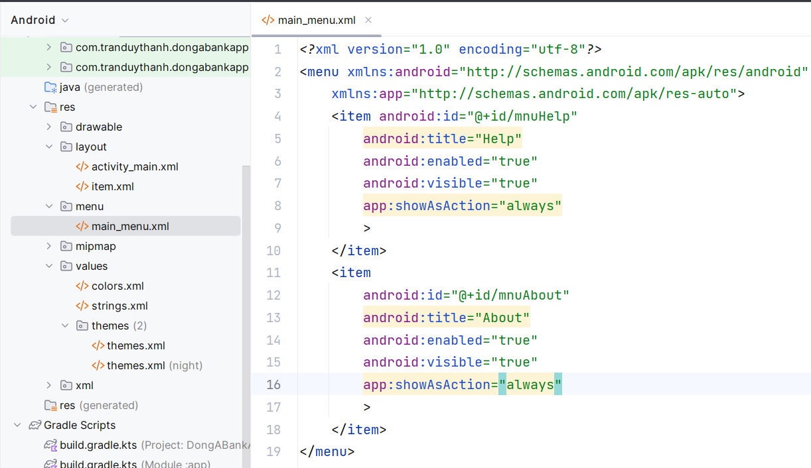
8.1. Option Menu
Step 2: Create menu resource xml

Slide 46
8.1. Option Menu
Step 3: Assign option menu for Activity
@Override public boolean onCreateOptionsMenu(Menu menu) { MenuInflater inflater=getMenuInflater(); inflater.inflate(R.menu.main_menu, menu); return true; }

Slide 47
8.1. Option Menu
Step 4: Handling events
@Override public boolean onOptionsItemSelected(MenuItem item) { if(item.getItemId()==R.id.mnuHelp) { Toast.makeText(this,"Do Help",Toast.LENGTH_LONG).show(); } else if(item.getItemId()==R.id.mnuAbout) { Toast.makeText(this,"Do About",Toast.LENGTH_LONG).show(); } return super.onOptionsItemSelected(item); }

Slide 48
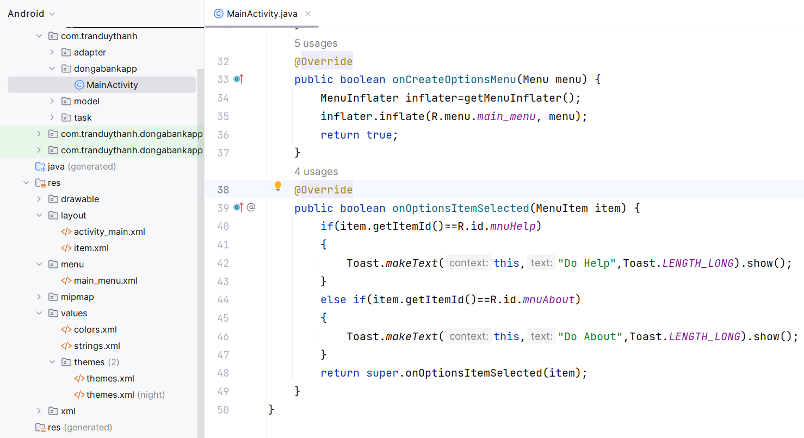
8.1. Option Menu

Slide 49
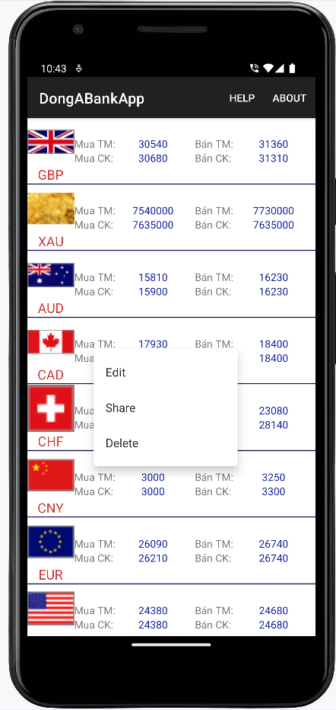
8.2. Context Menu

Slide 50
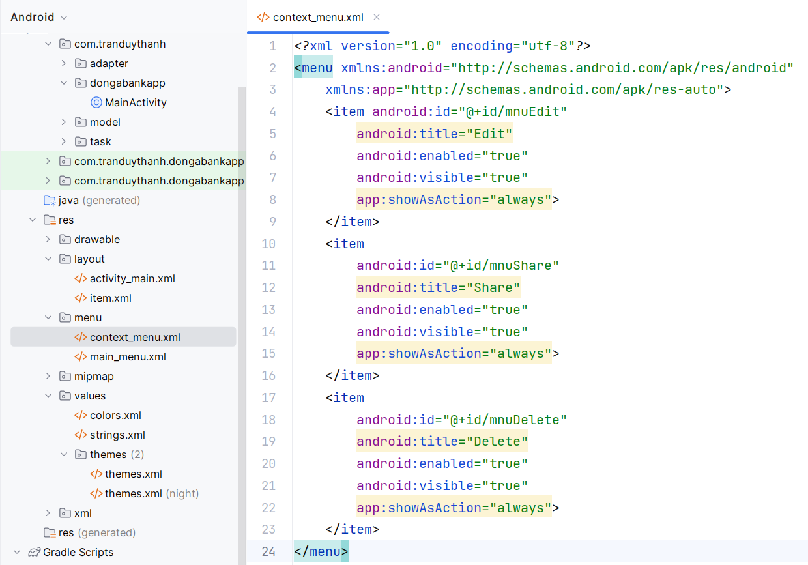
8.2. Context Menu
Step 1: Create context menu resource xml

Slide 51
8.2. Context Menu
Step 2: Assign context menu resource file for Activity
@Override public void onCreateContextMenu(ContextMenu menu, View v, ContextMenu.ContextMenuInfo menuInfo) { super.onCreateContextMenu(menu, v, menuInfo); MenuInflater inflater=getMenuInflater(); inflater.inflate(R.menu.context_menu, menu); }

Slide 52
8.2. Context Menu
Step 3: register Context Menu for View
registerForContextMenu(lvTiGia);

Slide 53
8.2. Context Menu
Step 4: Handling events
@Override public boolean onContextItemSelected(MenuItem item) { if(item.getItemId()==R.id.mnuEdit) { Toast.makeText(this,"Do Edit",Toast.LENGTH_LONG).show(); } else if(item.getItemId()==R.id.mnuShare) { Toast.makeText(this,"Do Share",Toast.LENGTH_LONG).show(); } else if(item.getItemId()==R.id.mnuDelete) { Toast.makeText(this,"Do Delete",Toast.LENGTH_LONG).show(); } return super.onContextItemSelected(item); }

Slide 54
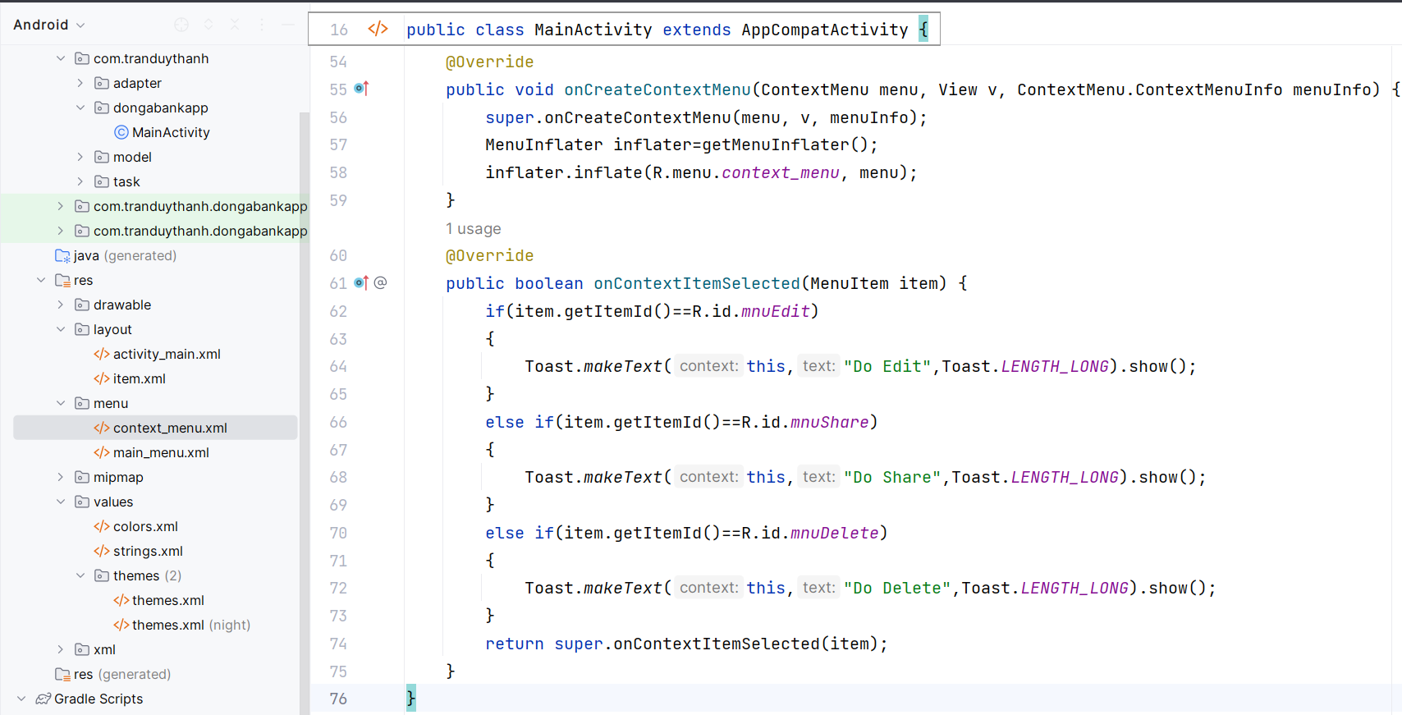
8.2. Context Menu

Slide 55
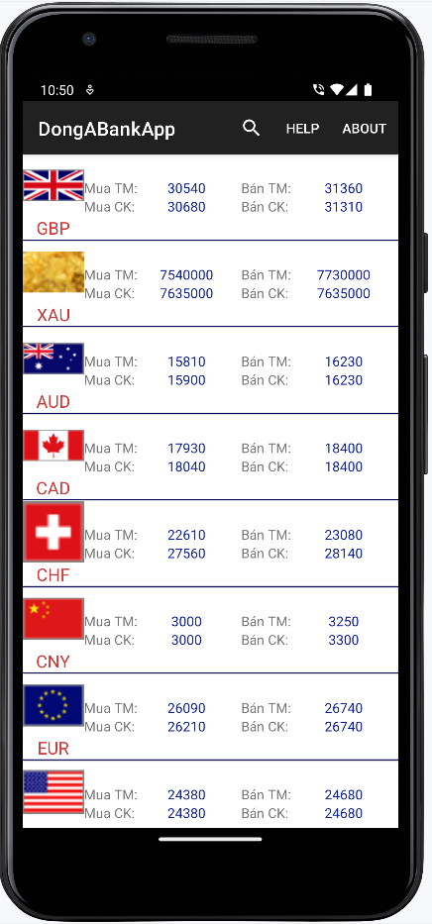
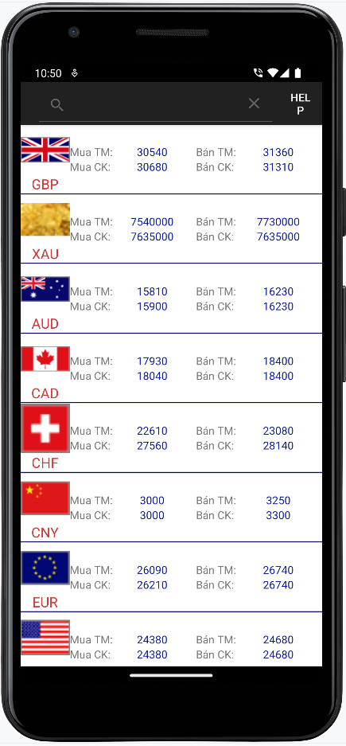
8.3. Menu Search View

Slide 56
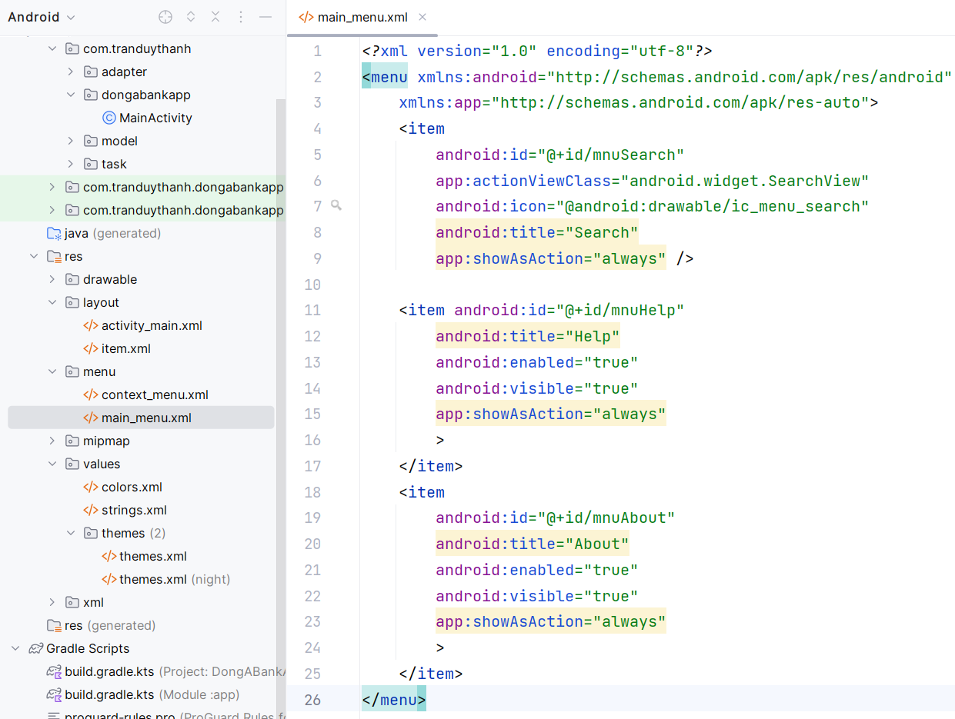
8.3. Menu Search View

Slide 57
8.3. Menu Search View
public boolean onCreateOptionsMenu(Menu menu) { MenuInflater inflater=getMenuInflater(); inflater.inflate(R.menu.main_menu, menu); MenuItem mnuSearch=menu.findItem(R.id.mnuSearch); SearchView searchView= (SearchView) MenuItemCompat.getActionView(mnuSearch); searchView.setOnQueryTextListener(new SearchView.OnQueryTextListener() { @Override public boolean onQueryTextSubmit(String s) { return false; } @Override public boolean onQueryTextChange(String s) { //process s return false; } }); return true; }

Slide 58
Discussions
Q1: Present the basic Listview programming steps
Q2: Present advanced Listview programming steps
Q3: Present the steps to program RecyclerView
Q4: Present the steps of Gridview programming
Q5: Demonstrate how to interact with data on DatePicker and TimePicker
Q6: Demonstrate how Spinner and ListView interact, for example we have Categories and Products.
Q7: Present the working mechanism of AutocompleteTextView
Q8: Demonstrate how to use Tabhost

Slide 59
Next Lesson
Activity
Intent
Implicit Intent & Explicit Intent
Transfer data between Activities

Slide 60
THANK YOU!

